Slide 1
The Danish Game Factory
VR & The Cinematic Future
Notes:
History of VR? VR gear today? Experiencing VR Findings? Examples.

Slide 2
- The Game industry -

Slide 3
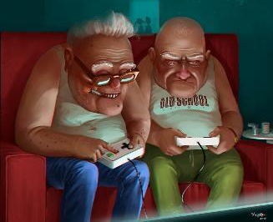
The Game Industry
Notes:
Twice the revenue of the movie industry
New AppStore release every minute
The average gamer is 37 years old
1.5 billion players
8% yearly growth rate
48% female

Slide 4
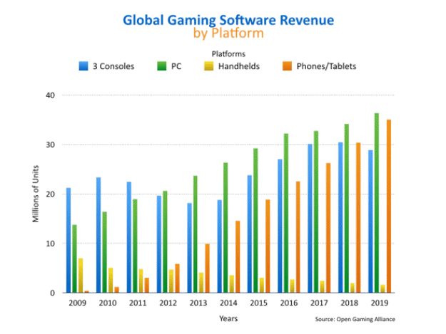
The game industry
Notes:
2016 - Oculus: 350.000, Vive: 450.000, PlayStation: 750.000, GearVR: 2.300.000

Slide 5
- from past to present -

Slide 6
Striving for more immersiveness

Slide 7
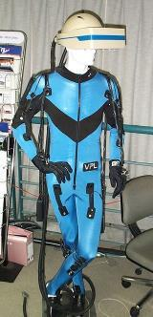
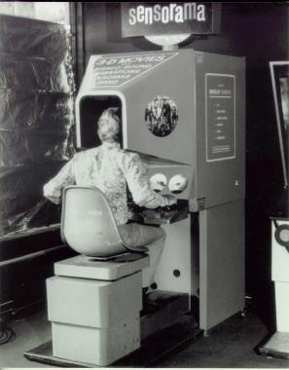
Striving for more immersiveness
Anaglyph 1852
Sensorama 1962
Omnimaxx 1973
Data Suit 1989

Slide 8
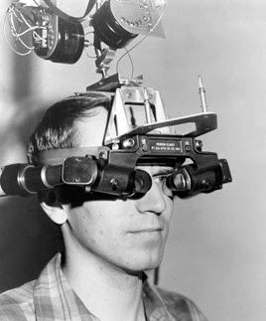
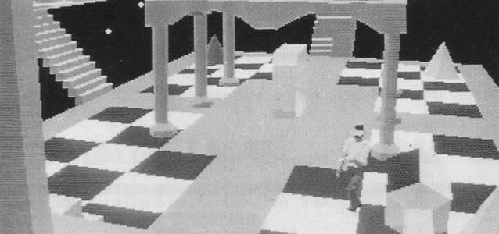
The sword of damocles - 1968

Slide 9
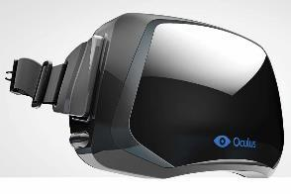
high end products

Slide 10
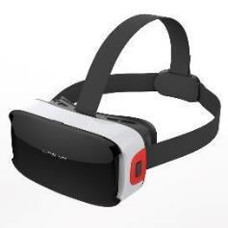
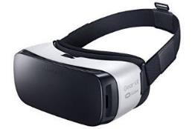
Low end products
Notes:
Smartphones, ling

Slide 11
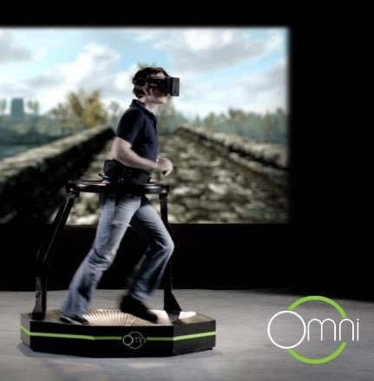
Move

Slide 12
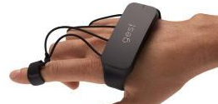
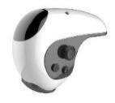
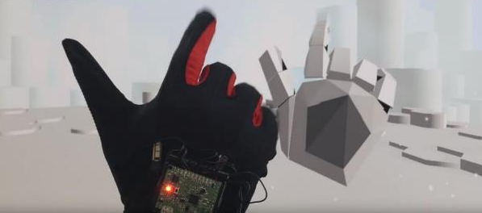
touch

Slide 13
touch
Notes:
Feel the movie

Slide 14
- Live action Recording -

Slide 15
Sphericam 2
4k
60 fps
monoscopic
Notes:
4k, 60fps, monoscopic

Slide 16
jump
16 Gopro
postproduction
stereoscopic
Notes:
Stereoscopic, 16 Gopro, heavy computing power

Slide 17
- Experiencing VR -

Slide 18
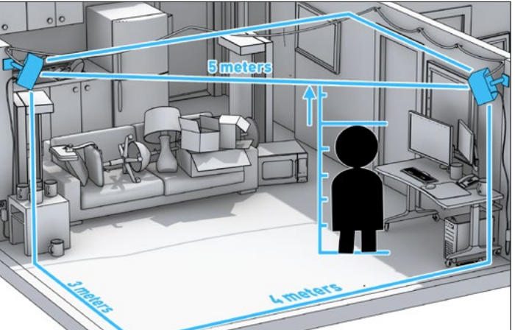
Room scale

Slide 19
Alone or together

Slide 20
Intense immersion
Notes:
For how long should the immersive experience last?

Slide 21
Focus
Notes:
Where are your eyes supposed to look in 360 degree universes?

Slide 22
Who are you?

Slide 23
Part of the audience
Notes:
sitcom

Slide 24
An extra at the movie set
Notes:
The movie recognizing your existence.

Slide 25
With friends

Slide 26
- Coherent Interaction -
Notes:
It needs to make sense

Slide 27
UI
Notes:
The UI design, options and mechanics should always be connected closely to the rest of the game

Slide 28
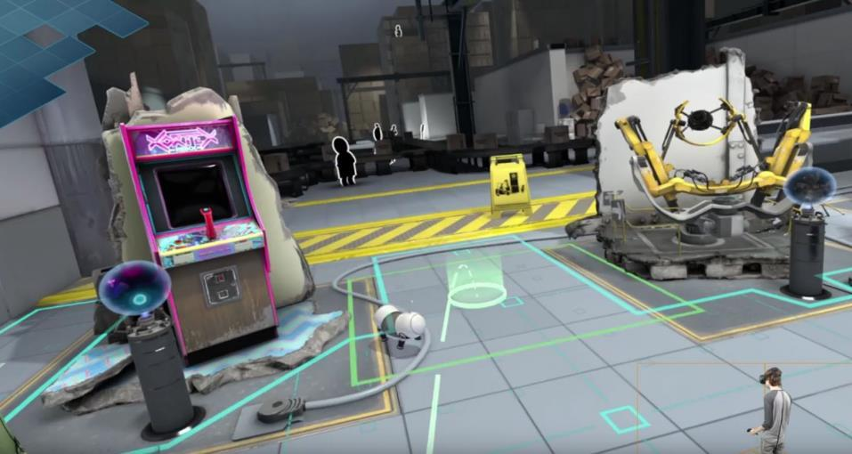
Motion Sickness
Notes:
Teleport vs fade to black

Slide 29
Branches in the narrative flow
Notes:
Branched stories; which one is the best story? What’s THE End (not A end)

Slide 30
Pause
Notes:
What happens when you pause?

Slide 31
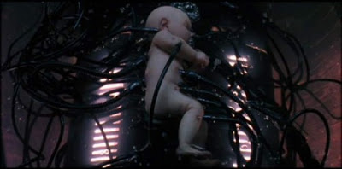
What happens if you die?
Notes:
Explanations when you die - linear story telling and replayability (Source Code)

Slide 32
Silly or not
Notes:
Silly choices needs to be consistent, or they will disrupt the flow. Not just dialogue lines but also actions (goat simulator).

Slide 33
- Examples -

Slide 34
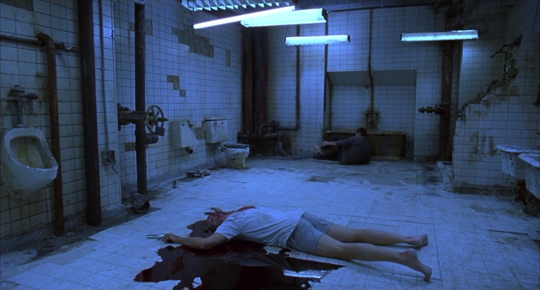
Horror
Notes:
Escape Room – 5 Nights at Freddy’s

Slide 35
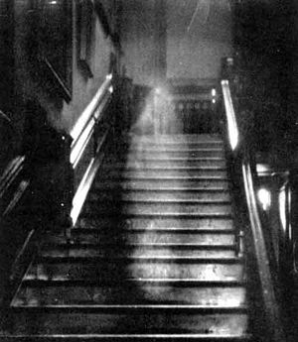
Crime
Notes:
Ghost Story

Slide 36
Thriller
Notes:
Highjacked plane

Slide 37
war
Notes:
Zoom in and out.

Slide 38
The butterfly effect
Notes:
God makes small changes to make Adam the new Jesus Christ.

Slide 39
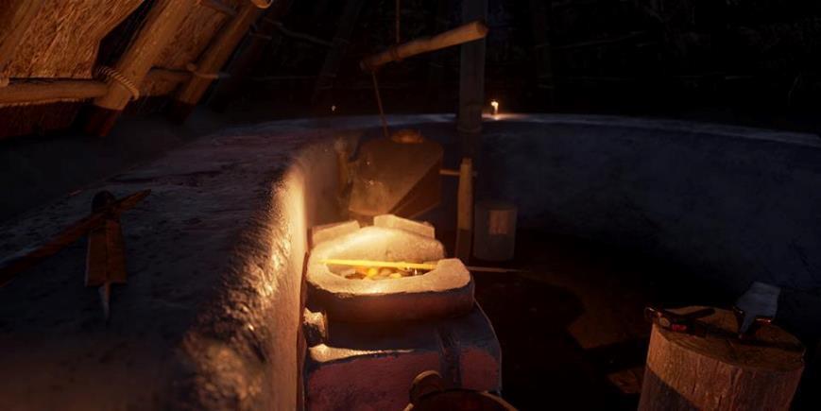
History
Notes:
Conversations of the most influencial humans to walk the earth.

Slide 40
Documentary

Slide 41
Art

Slide 42
Sci-Fi

Slide 43
?
Notes:
Spørgsmål?

